Slide 1

CHRISTUS Health
Monthly Status- monthyear

Slide 2
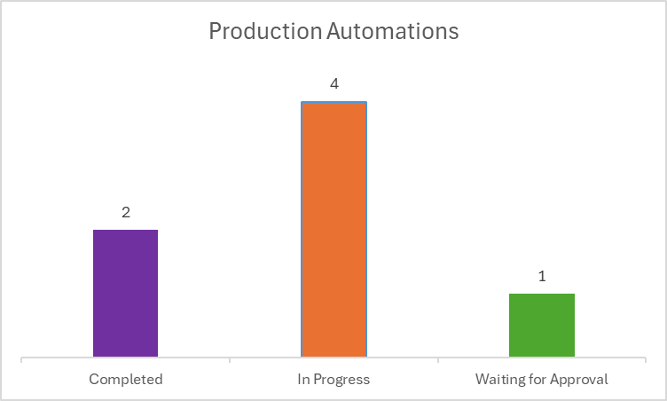
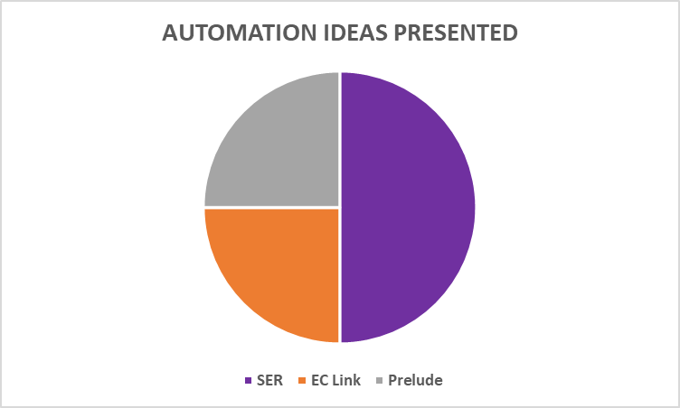
Test Automation
Key Achievements
Team has developed automation for around 70+ Scripts so far
Enhanced selector efficiency for EPIC automation scripts from 50% to 100% by directly passing the argument into selectors , enabling accurate, consistent, and reusable logic across future projects.
The DEA and CDS processes for HealthPlans have been successfully launched in the production environment.
Team members are also working on redevelopment of production processes and tracking the production processes logs on daily basis which adds to our scope of work expansion
Presented an automation idea related to Workqueue Automation for SER Modules
Goals- nextMY
Scope
Tripple Upgrade Regression Testing starting from 29th Sep,2025.
Monitor
Monitor all scripts on triggers and in production accurately
Collaborate
Collaborate both internally and explore external ideas for Automation
Tracking
Maintain up-to-date data for Trackers
Note: The data reflects the status per the month of August, considering modules involved

Slide 3
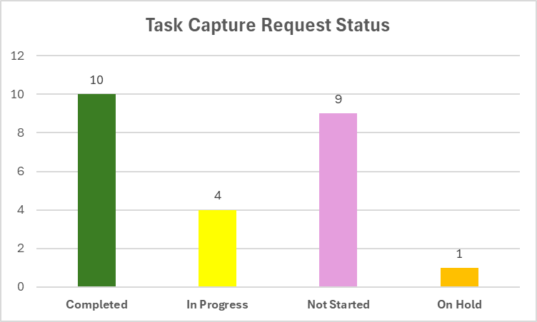
Quality Assurance
Key Achievements
Goals for nextMY
Task Capture Script Review
Performed Multiple Reviews for the Ready to Task Capture scripts, to ensure accuracy prior Task Capture as the captured workflow serves as the basis for automation.
Task Capture
To Review 14 test cases to validate accuracy and alignment of business requirement. Following the review, each testcase will be documented using task capture to prepare them for automation in UiPath.
Task Capture Script update
Workflow changes identified during the review were incorporated into the scripts, Supporting efficient Test Suite Maintenance.
Triple Upgrade Testing
To ensure early review and validation of test scripts, systematic execution for defect resolution, and timely completion of the testing cycle with quality deliverables.
Task Capture
Used UiPath Task Capture to Task Capture Test Cases for automation
Total: 24
Completed: 10
In Progress: 4
Not Started: 10
Module in numbers
Short Scripts Review
Reviewed Automation-Incompatible Test Cases to create Short Scripts out of them and make Automation Compatible.
Automation Collaboration
Partnered with the automation team to resolve script issues internally, minimizing client involvement and reducing delays.
Link to QA interactive Dashboard: Power BI Report for QA

Slide 4
EC-DC
Key Achievements
Module in numbers
Solution & Delivery
Provider on the Fly (POTF) Cleanup: Completed the verification and cleanup of POTF extracts for providers without NPI, successfully reducing the backlog from 3,000+ to under 50 records​.
POTF CSV Cleanup: Completed the cleanup of 450+ provider records for the New Mexico region, reducing outstanding records from 468 to under 50.
Executed Daily DC Provider Report: The team consistently ran the DC Provider maintenance report and successfully migrated over 1000 provider records from PRD to POC to TST environments throughout August.
Managed CMT Reports and Conducted Standards Audits: Ensured daily execution of the CMT Report, generated reports of Standard CMTs moved to PRD, and audited approximately 250 standards each week.
Resolved DC Migration SNOW Requests: Efficiently addressed and resolved over 150 DC Migration SNOW requests, ensuring builds were migrated to production.
Performed Quality Assurance for EHR Sub CAB and Peer Review Meetings: Conducted QA on major, minor, and standard candidate CMTs and change requests for peer review huddles and EHR Sub-CAB meetings. Managed pre-meeting responsibilities effectively.
Solution & Delivery
Implementations
Scope of work
Goals for nextMY
CIRT Documents Review:​ Revise and align CIRT (Critical Issue Response team) documentations with updated processes in collaboration with the team.
Duplicate Provider Cleanup: Develop an action plan to identify and remove duplicate SER records without NPI from the system.

